Slide 1

Dragons Den Presentation
By Arman Somal and Sarthak Nadkarni

Slide 2
Drip Cleaner
Our product name is called “Drip Cleaner”.
We choose this because this product is supposed to clean shoes, leather, or high end cloth.
The name relates a lot toward the vocabulary this generation uses such as Drip which is another word for swag.

Slide 3

How Much Are We Asking For?
For the product “Drip Cleaner”, the amount that we are asking for is $10,000 for 15%.

Slide 4
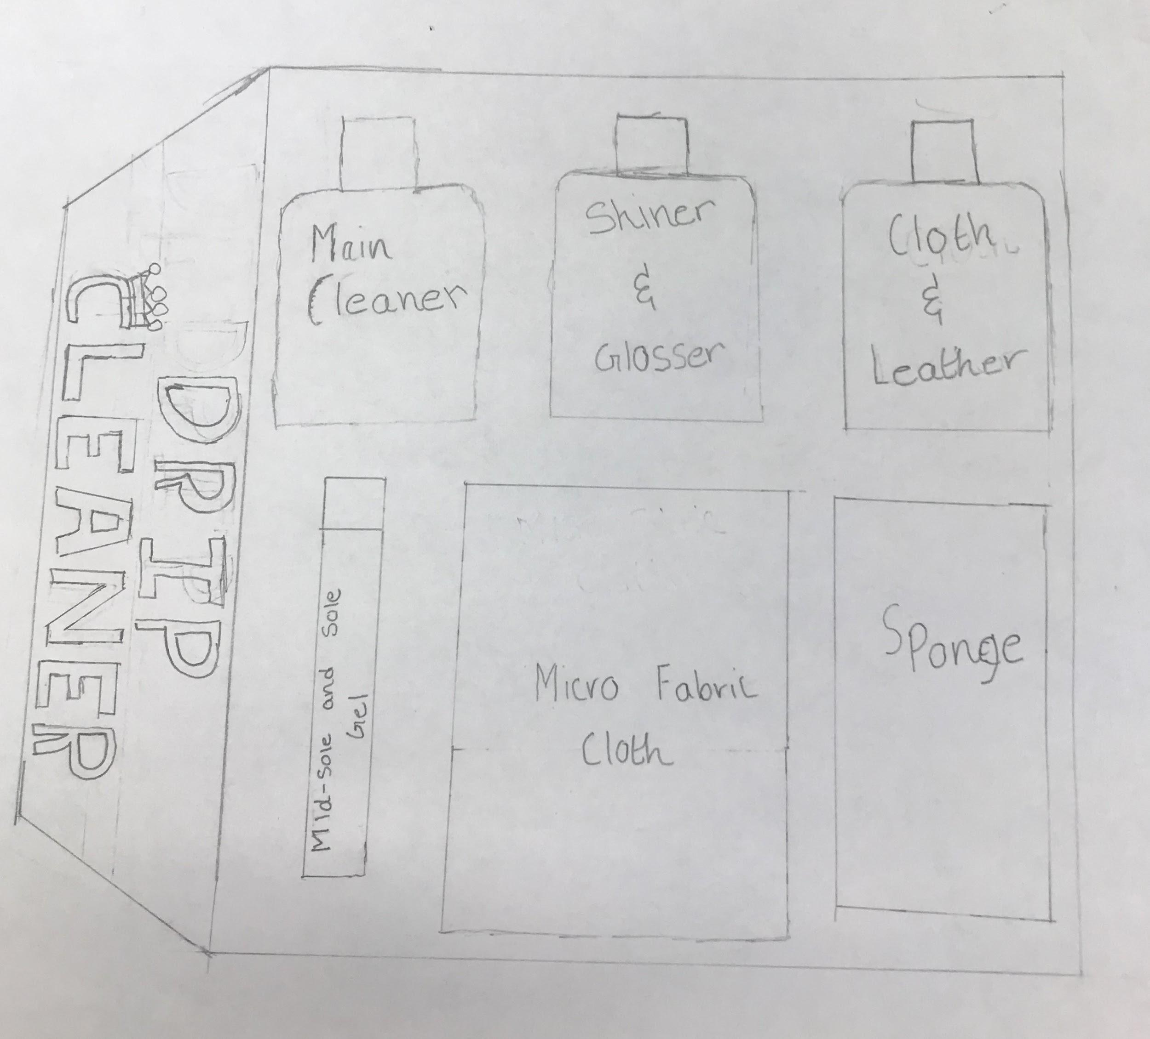
What is drip cleaner
Newest cleaning kit for shoes and leather.
This kit comes with:
Sponge and Micro Fabric Cloth
Main Cleaner, Cloth, and Leather Spray
Midsole and Sole gel
Shiner & Glosser

Slide 5
Drip Cleaner Pt.2
Looks like it understands the cleaning way of new generations
Contains No chemicals
Natural & Organic Ingredients
Eco Friendly
Disposable bottles
Washable and reusable sponge and cloth

Slide 6
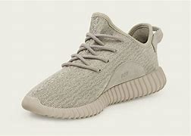
Our Target Market
Our target market is Models, Shoe Collectors, Teenagers, and Shoe Designers.
Always try to make their outfits look good.
Shoe collectors buy expensive shoes or limited in quantity.

Slide 7
Why Is Our Idea About Drip Cleaners Necessary?
To make shoes speaks for the personality.
It makes it easier to maintain the leather.
Prevents the item from being damaged from UV radiation (Ex. Like having fades and cracks).
Cleans stains and conditions the material (Ex. Leather Boots).

Slide 8
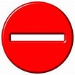
The Voids Associated With This Product And Ideas?
When shoes are broken and cannot be fixed, the drip cleaner won’t have the ability to fix it. That broken item is useless. This applies the same thing to leather in which it can only be cleaned.

Slide 9
What Do We Need In Order To Sell Drip Cleaners?
Create a proper marketing strategy (Ex. Finding a proper reason why in which customers would buy the product).
Find a proper percentage range in which we would receive enough money (Ex. $20,000 for 20%).

Slide 10
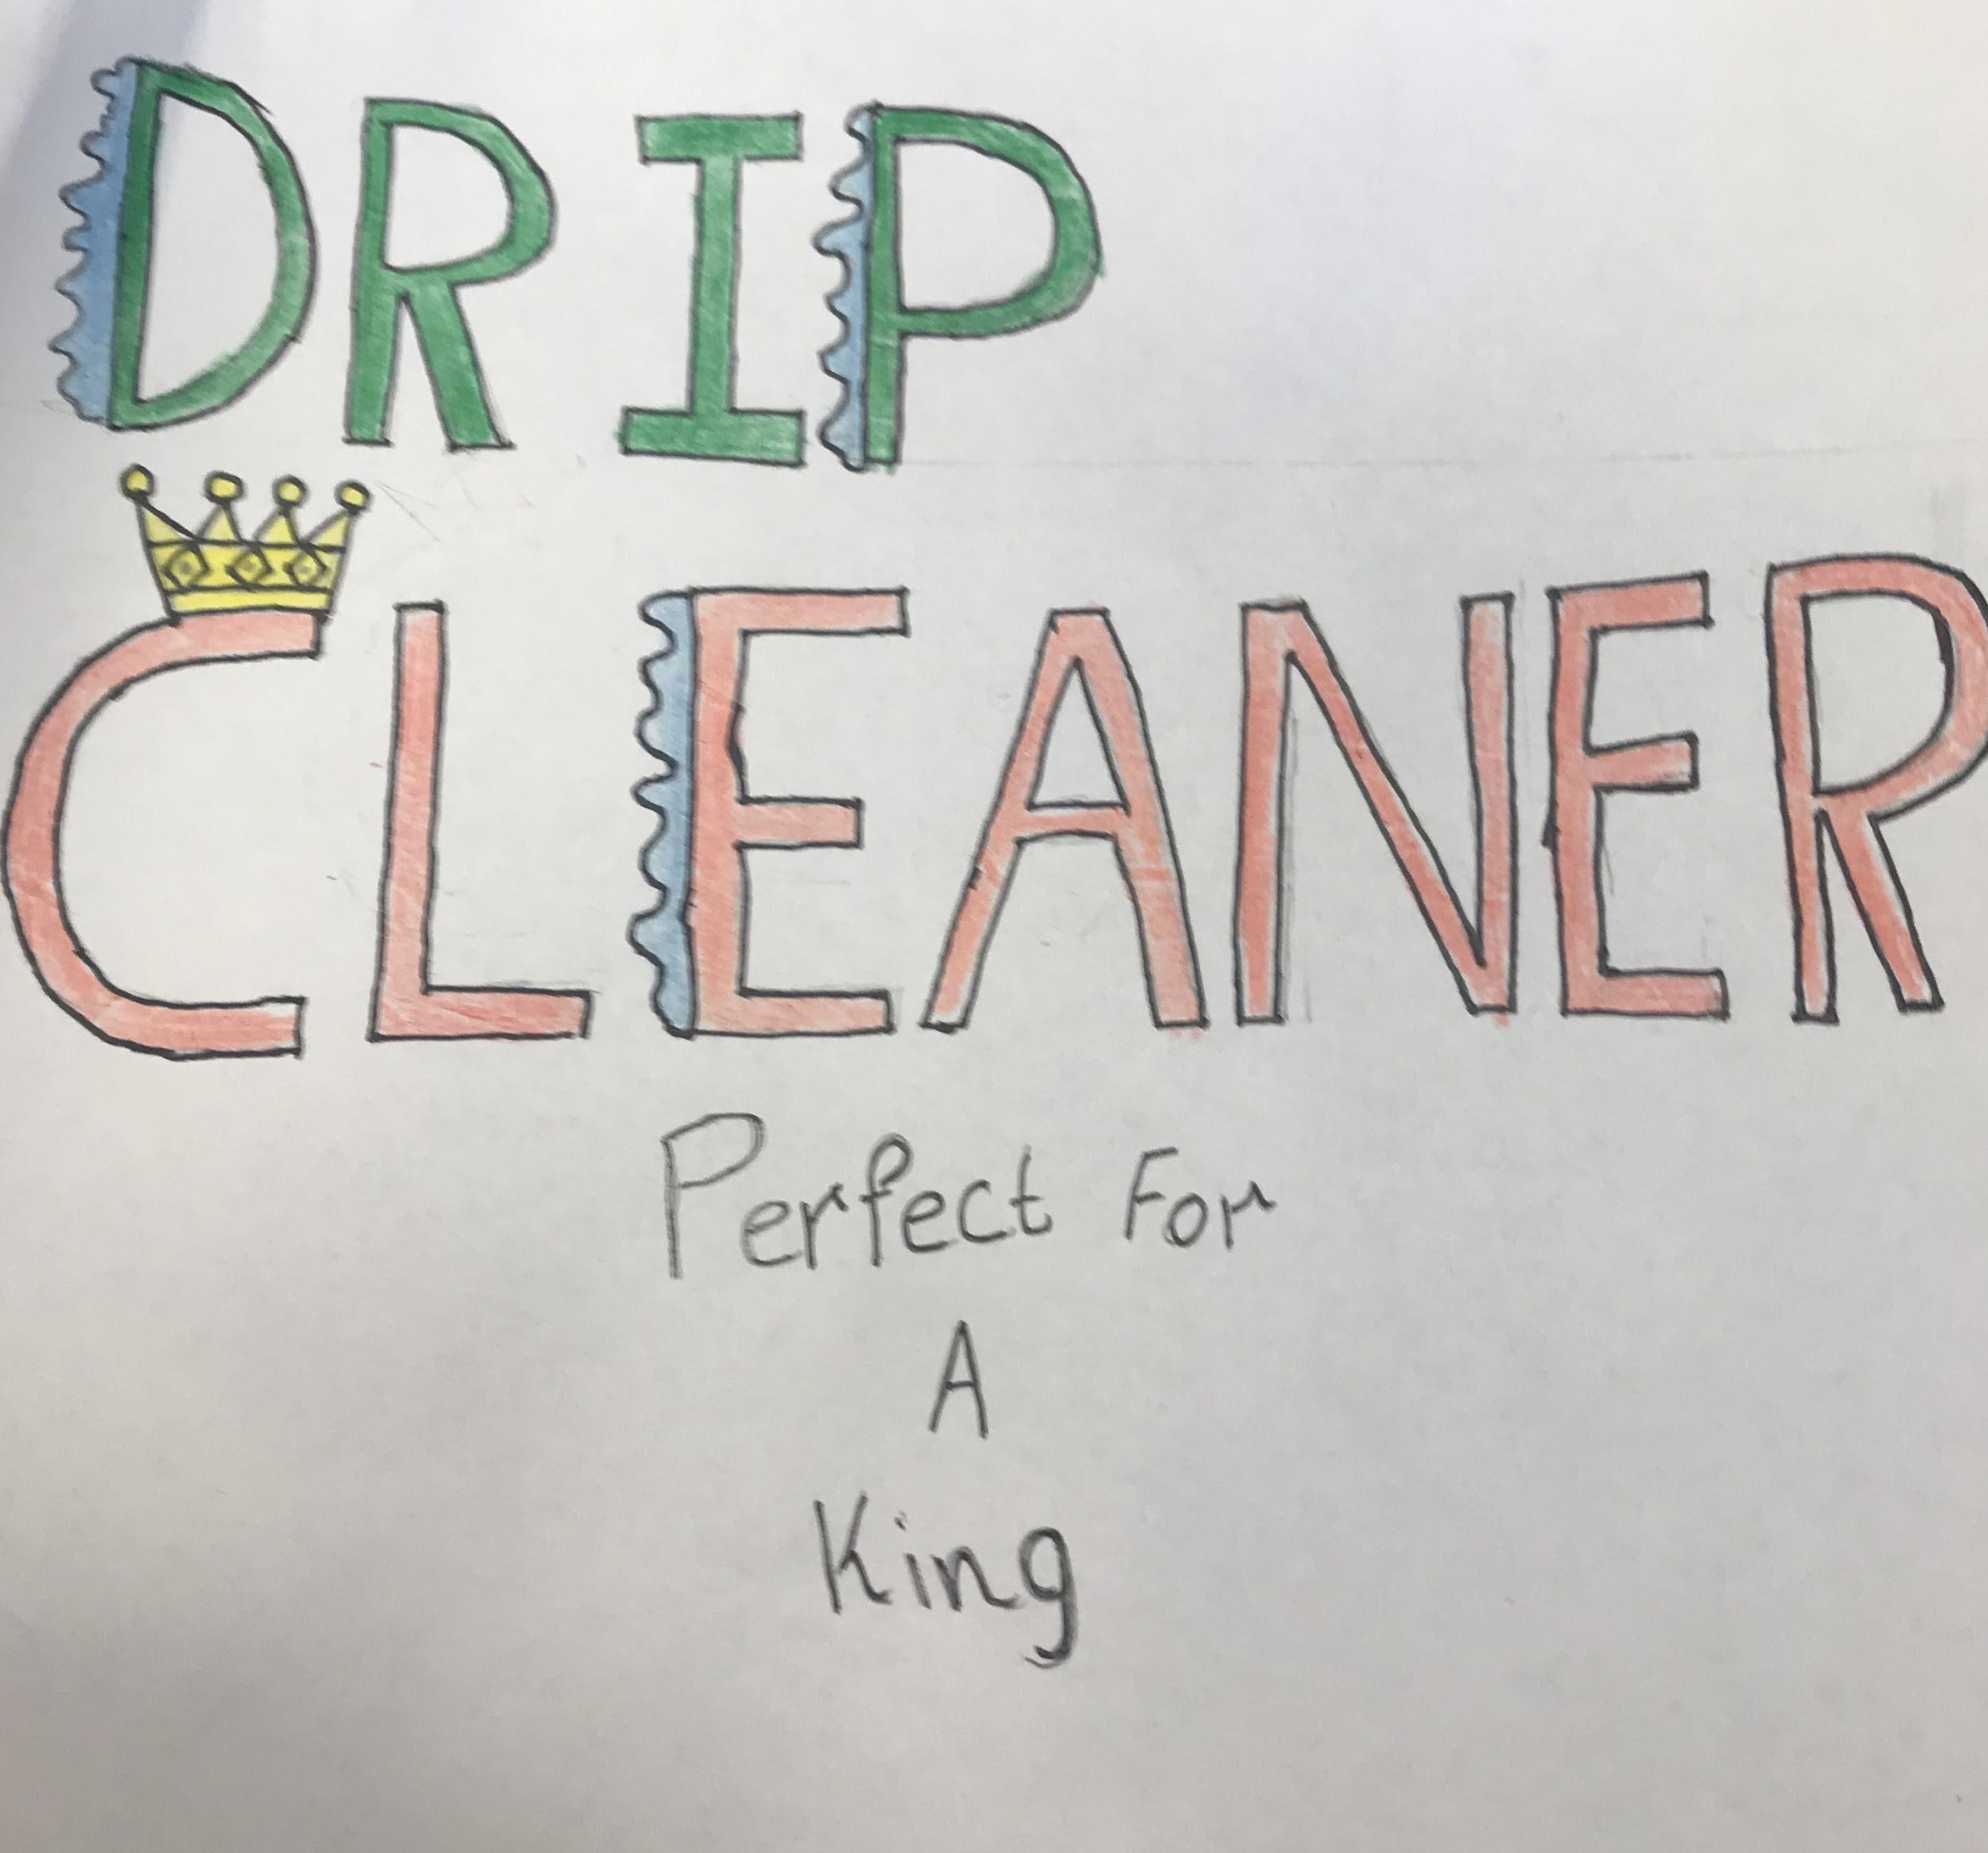
Product logo
The crown on the C relates to the slogan
Watery effect on the letter relates to the first word “drip”
Different colors for diversity
Logo is Monogrammatic

Slide 11
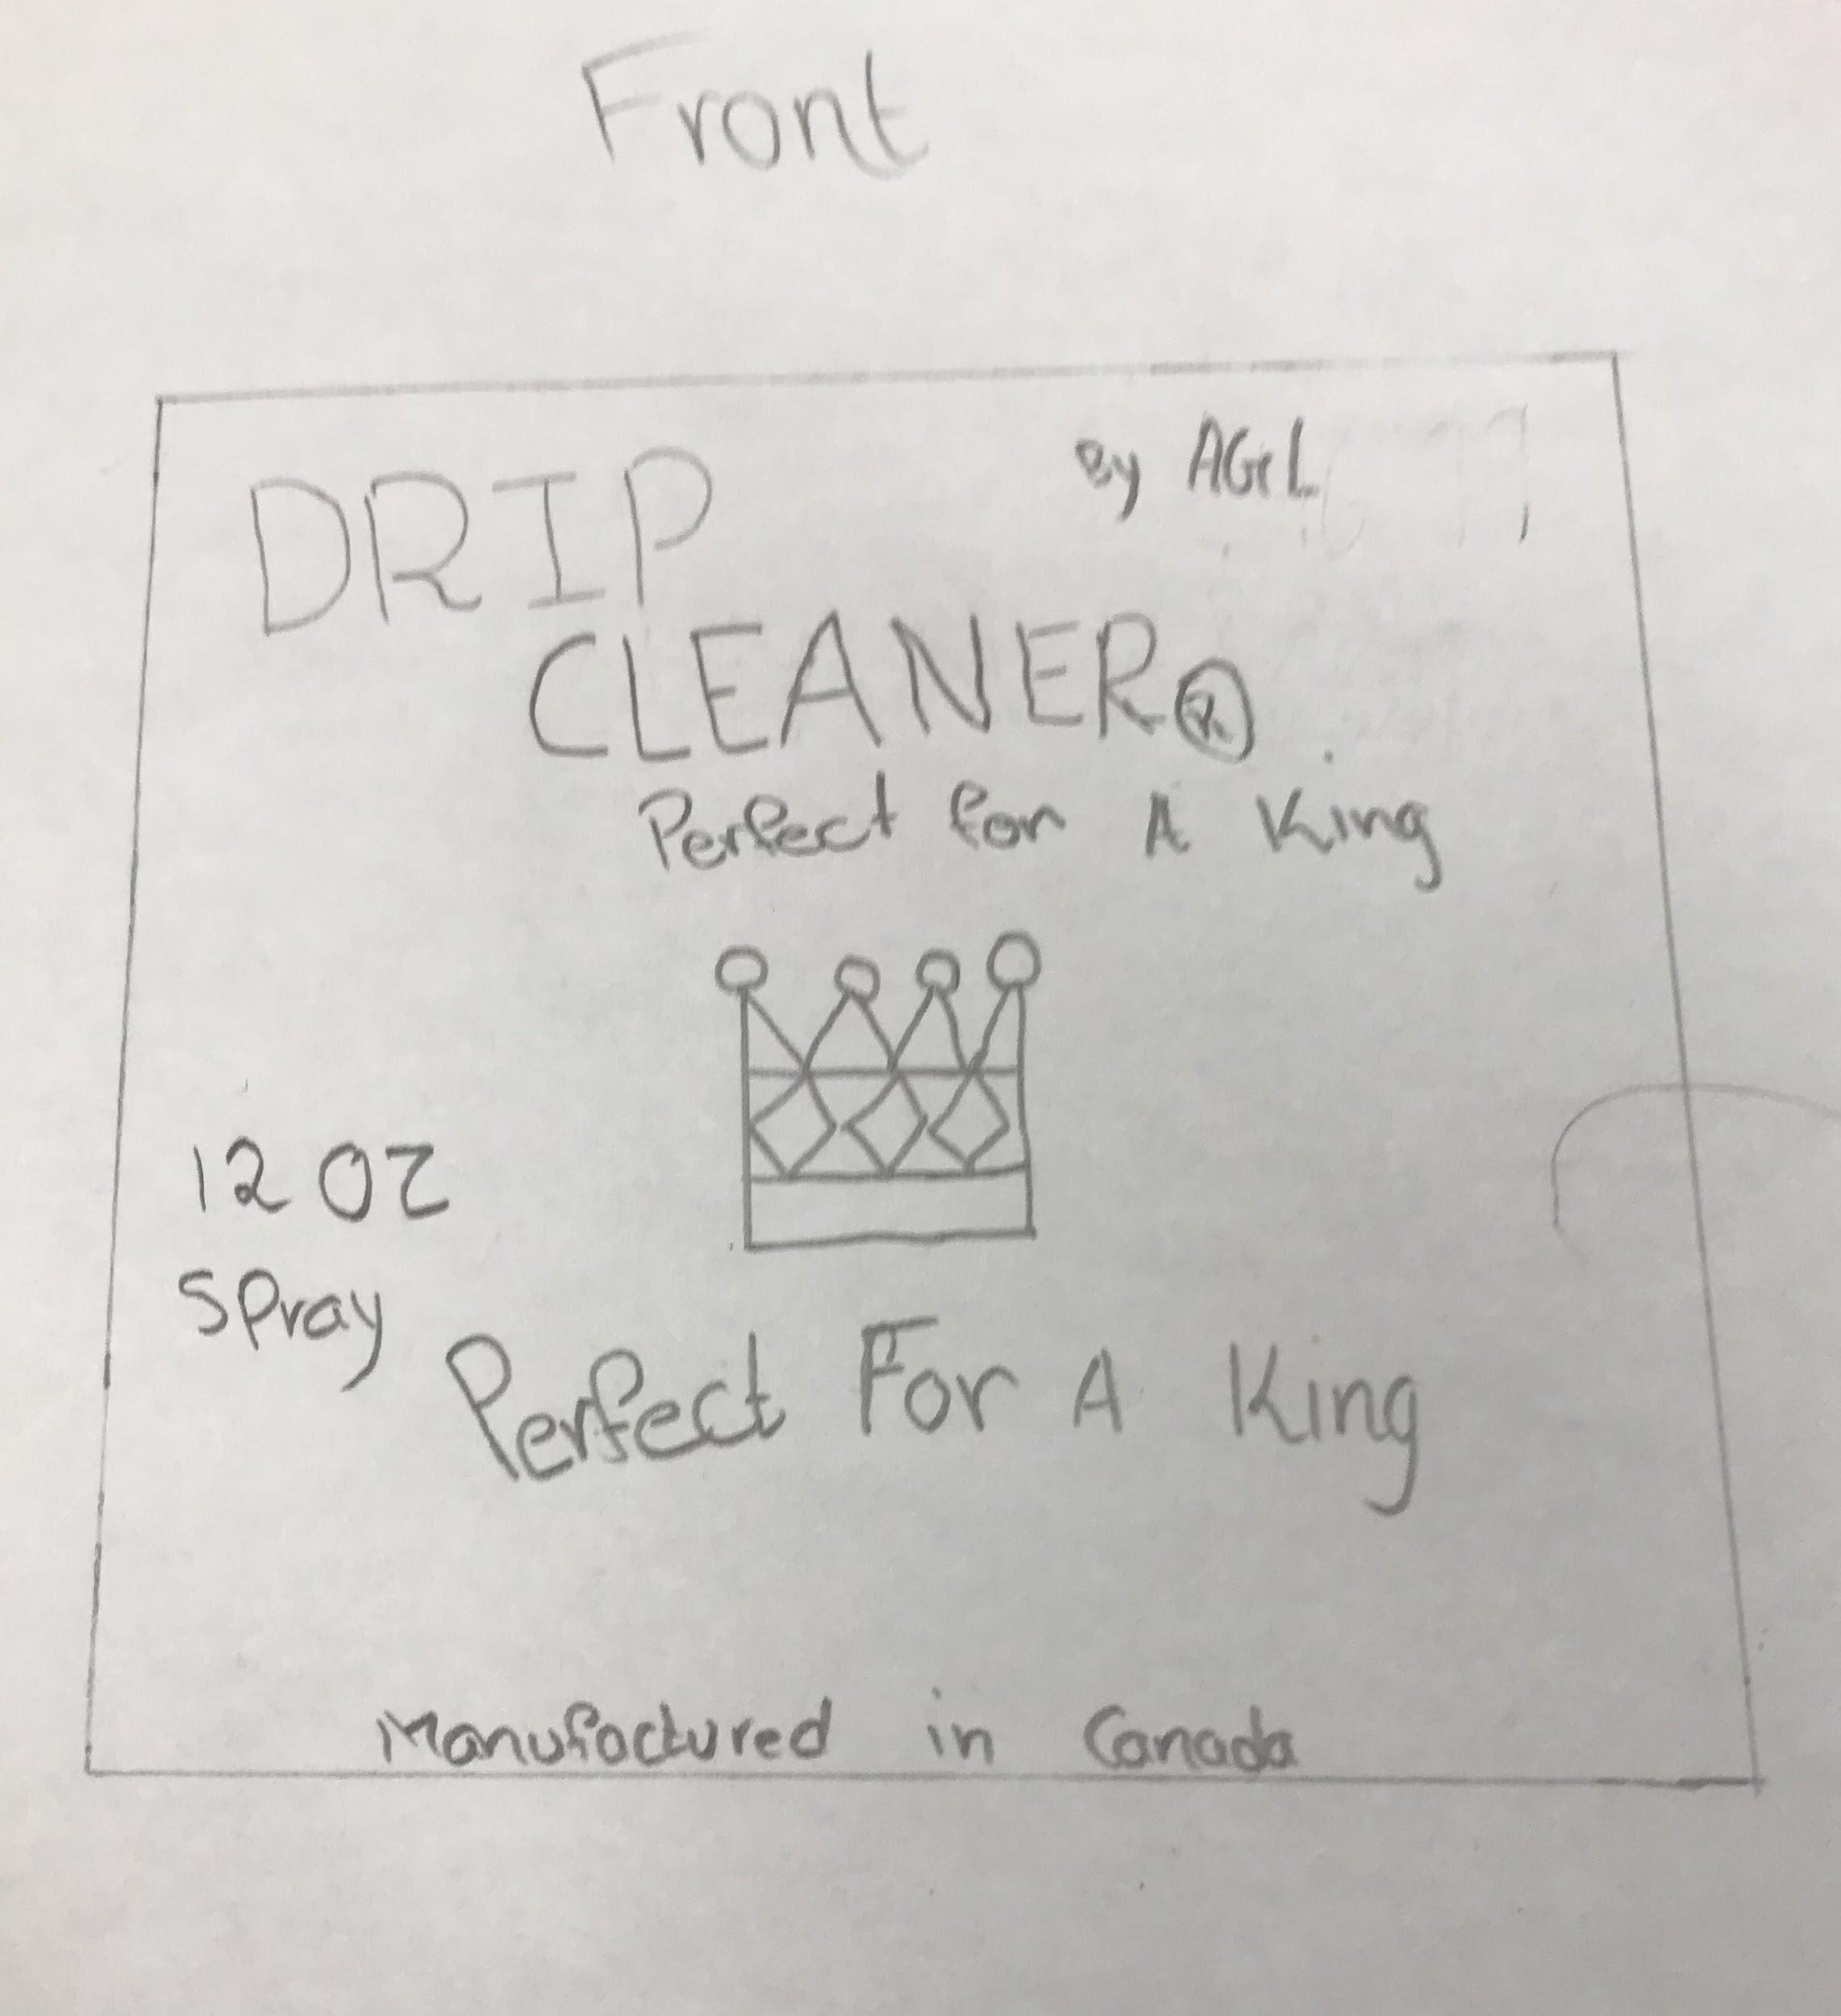
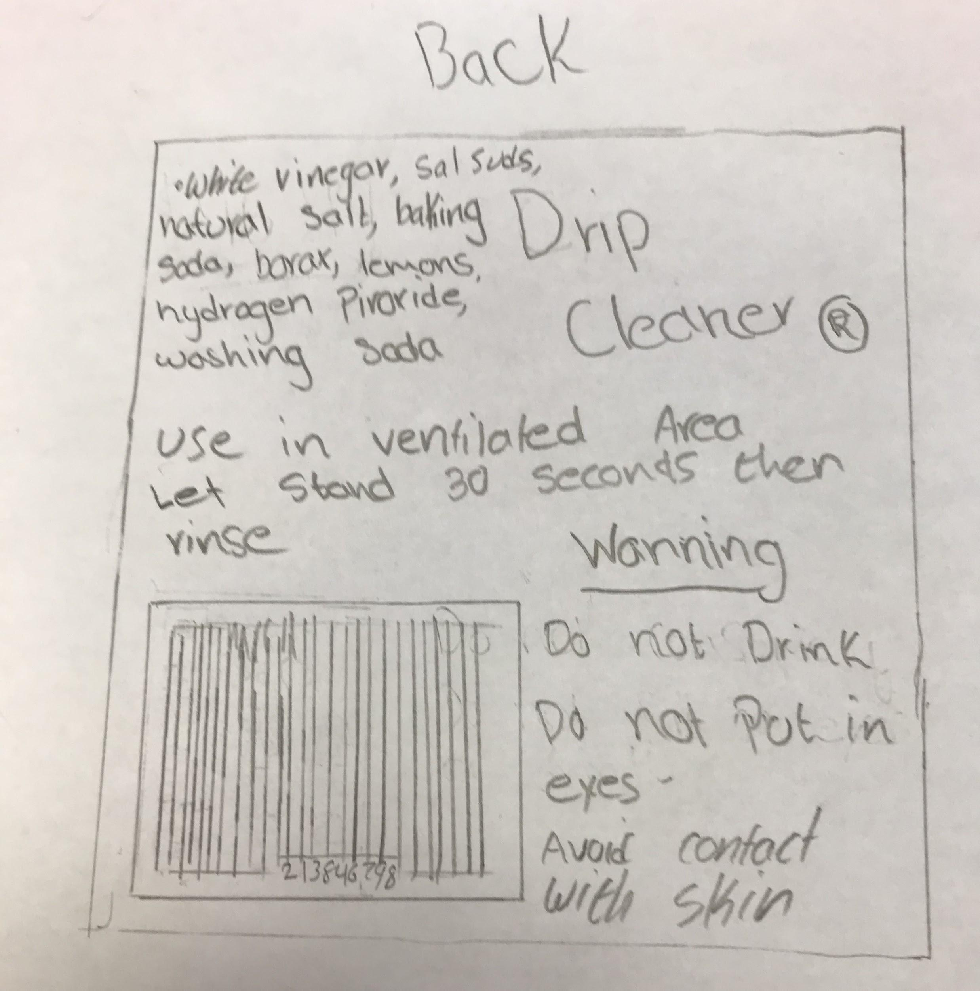
Packaging
Includes the ingredients
The Amount
Includes logo
The Slogan
Warning labels
The Scan code
Manufacturer and where it was manufactured
Instructions

Slide 12
Operating Cost
Spray - $3.49
Disposable bottles - $1.40
Cloth- $2.20
Box- $0.81
Making 25 Drip Cleaner kits
Cost: $197.5

Slide 13

Positioning
High quality
High performance
Reliability
Efficiency
Price
Knowledge

Slide 14
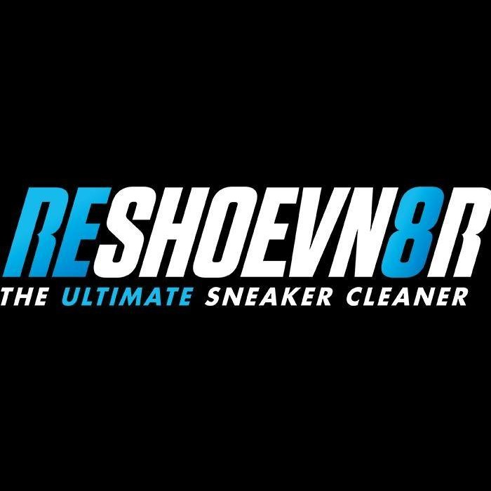
Main Competitors
Reshoevn8r
Whole kit- $137.99
Separate spray- $18
Brush- $27
Stain Repellent- $27

Slide 15

Main competitor
Jason Markk
Premium Bundle- $65.00
RTU Foam Spray
Brush
Microfiber Towel
Repel Spray
Suede Cleaning Brush

Slide 16
Price
6-Piece Cleaning kit- $46.99
3 12 oz Sprays
Microfiber cloth (12” x 12”)
Hand sponge
Midsole/Sole Gel (5 grams)
Cost lower than top shoe cleaning competitors by 40%

Slide 17
Where will the product be sold?
Lower parts of Canada, BC
Surrey
Delta
Langley
White Rock
Foot locker, Near nike stores and Mall Stands
Sell Expensive and good looking shoes.

Slide 18
Distribution Channels
Manufacturer to Retailer distribution channel.
Gives the customer more to look at.
Respond to product performance and customer feedback.
A channel of indirect distribution.
Manufacturer does not distribute direct to the end-user.

Slide 19
Thanks for listening

